Slide 1
Problem Statement
Intel Products Sentiment Analysis from Online Reviews

Slide 2
Unique Idea Brief (Solution)
The project's uniqueness lies in the combination of DistilBERT for accurate sentiment identification, Gemini for trend analysis of positive sentiment, and seamless integration with a web application for clear visualization. This multi-stage approach with LLMs allowed you to gain valuable insights into user sentiment for Intel processors over time.

Slide 3
Features Offered
Predict Sentiments for Reviews: Classify reviews as positive, negative, or neutral using sentiment analysis.
Positive-Negative Trend Over Years: Track sentiment trends in reviews from 2012 onwards using visual graphs.
Technical Specifications Insights: Extract and summarize key technical specifications from reviews.
Reviews Starting from 2012: Focus analysis on reviews written from 2012 to the present.
Features Offered: List features of products based on review analysis and specifications.

Slide 4
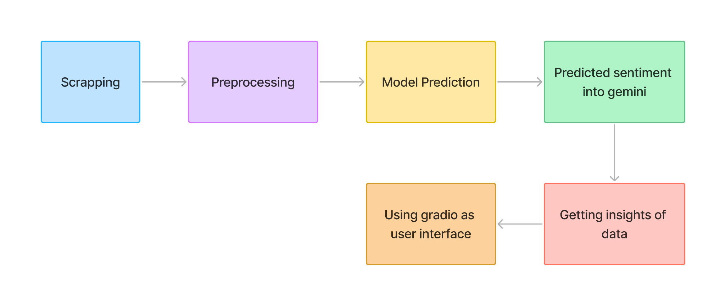
Process flow

Slide 5
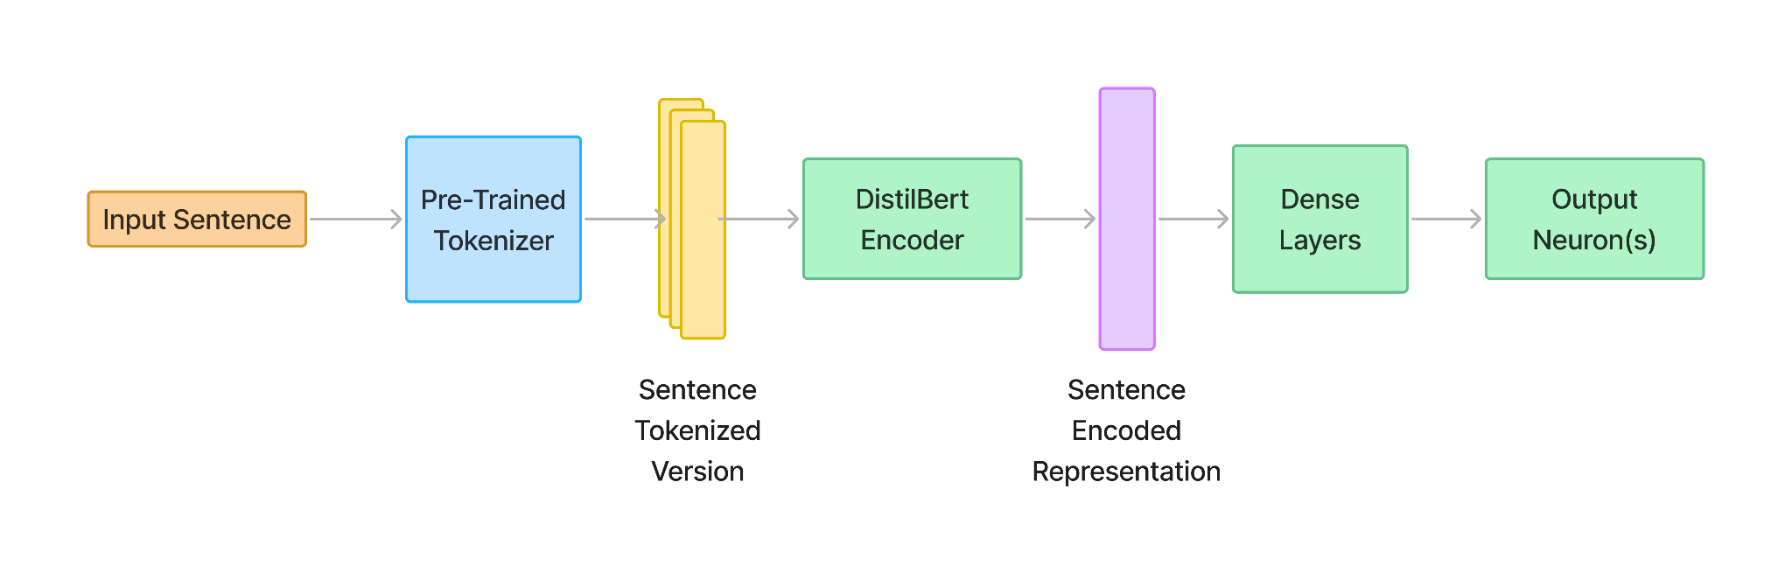
Architecture Diagram

Slide 6
Technologies Used
Data Scraping and PreProcessing
Selenium
Beautiful Soup
Pandas
Google Colab
Machine Learning
Transformer
PyTorch
Logistic Regression
DistilBert
Kaggle
Google colab
Data analysis and Visualisation
Power BI Desktop and Service
Microsoft Excel
Gradio
Google Colab

Slide 7
Team members and contribution:
Kumar Priyanshu:
He was in charge of the thorough data collecting using a variety of techniques, making use of sophisticated web scraping tools like Beautifulsoup and Selenium. He handled data files with efficiency and completed necessary cleaning and preparing work. This required making sure the data was accurate, dependable, and prepared for analysis by eliminating inconsistencies, fixing mistakes, and standardizing formats.
Avishikta Bhattacharjee
She has designed a multi-stage system: a logistic regression model set the baseline, while a fine-tuned DistilBERT model identified sentiment in tech reviews. Positive sentiment from DistilBERT was then analyzed by Gemini, another large language model, to uncover trends. Finally, the she has integrated Gemini with the Gardio web app, allowing visualization of these positive trends. This clever combination of models provided valuable insights into user sentiment.
Akangkha Sarkar
She was responsible for data visualization and analysis in this project. Leveraging tools such as Power BI and Excel, she has data to derive meaningful insights. Additionally, she has developed a Gradio-based web interface to effectively present the project findings. This interface not only enhances the accessibility of the results but also ensures a seamless and engaging user experience.

Slide 8
Conclusion
After gathering the data and performing sentiment analysis on the reviews, we gained insights into the top 10 Intel processors based on their sentiment scores in two distinct categories: user reviews and technical reviews. In this sentiment analysis, reviews classified as positive were assigned a score of +1, while negative reviews received a score of 0. By summing these sentiment scores, we determined which processors had the highest positive sentiment across both categories. The results of this analysis provided a ranking of the Intel processors based on the highest sentiment scores, reflecting the overall positive reception of these processors in user and technical reviews.

